Slide 1


WELCOME
Session 4 of 8
Theme:
SELF-CONFIDENCE &
SELF-ESTEEM

Slide 2
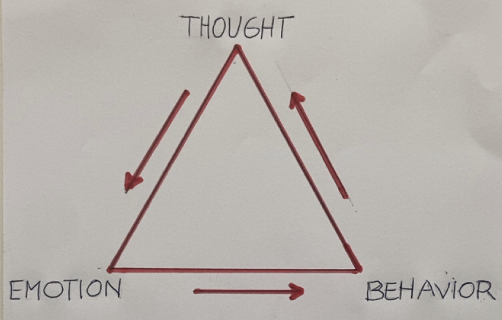

«If you want something new in your life, you need to do something new!»

Slide 3
Triggering Situations
School & homework
Social Media
Friendships
Family
Romantic Relationships
Body image and self-esteem
Public Speaking
«If you want something new in your life, you need to do something new!»

Slide 4
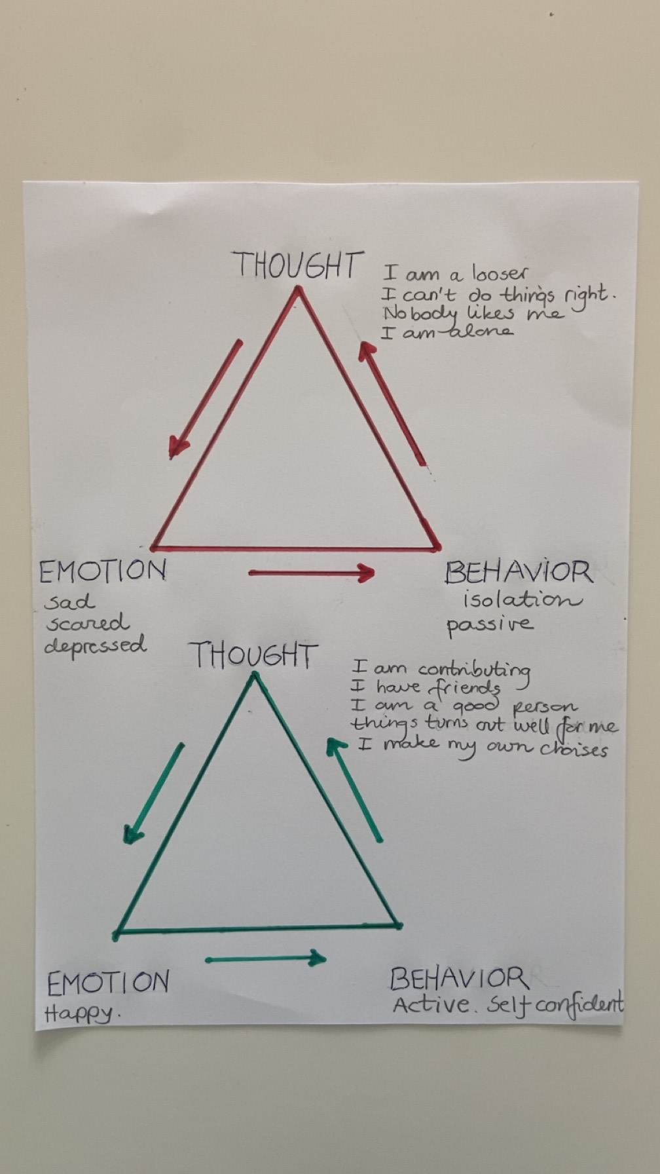
«If you want something new in your life, you need to do something new!»

Slide 5
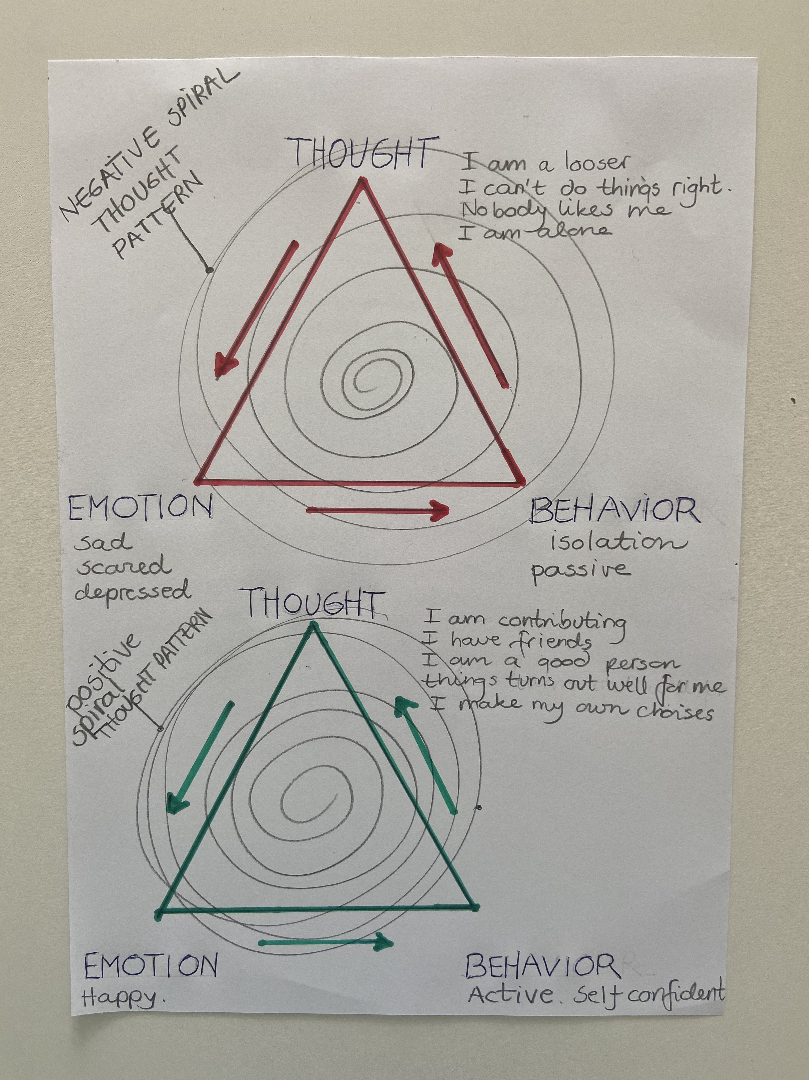
«If you want something new in your life, you need to do something new!»

Slide 6
Home Assignment
Use the cognitive triad! When you notice that you are in the red triad, think/say: Stop! You are not welcome here!
Replace it with one positive thought from your green triad.
«If you want something new in your life, you need to do something new!»

